Slide 1

Literature Review
XAI in NLP
Group 6

Slide 2


Black-Box AI
XAI
Black-Box Model
Interpreted Model

Slide 3
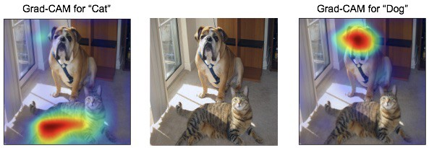
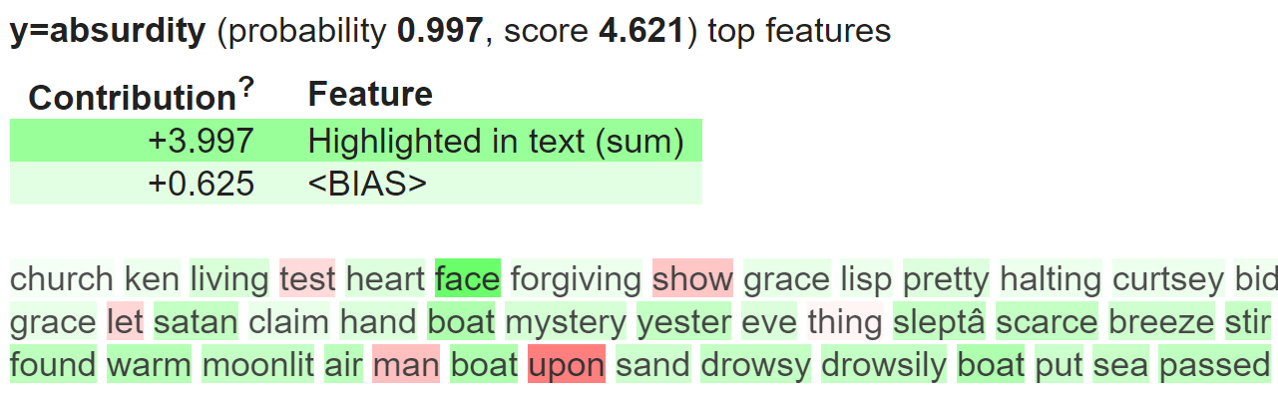
What is XAI ?
Acronym for “Explainable AI”
NLP
CV

Slide 4
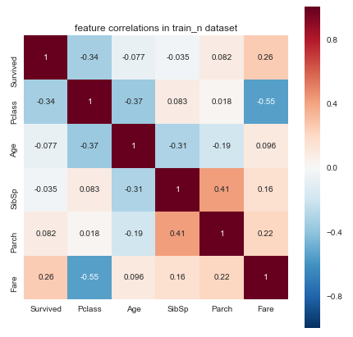
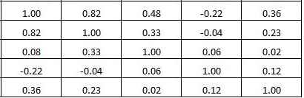
Explainability OR Visualization
Correlation as example
Explain
Visualize

Slide 5
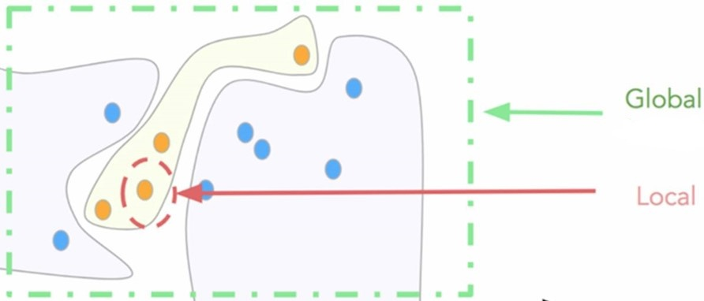
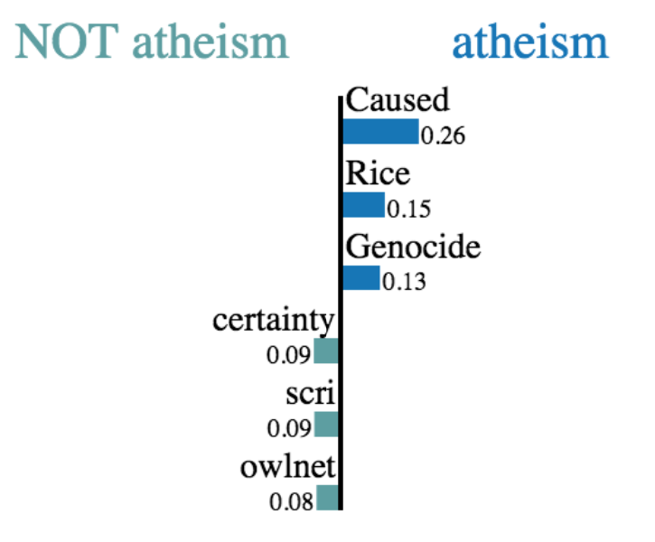
XAI: Main Categories
XAI
Locality
Local
Global
Post-Process
Self-Explain
Post-Hoc
Model.
feature_importances_

Slide 6
Self- Explaining
Global vs Local

Slide 7
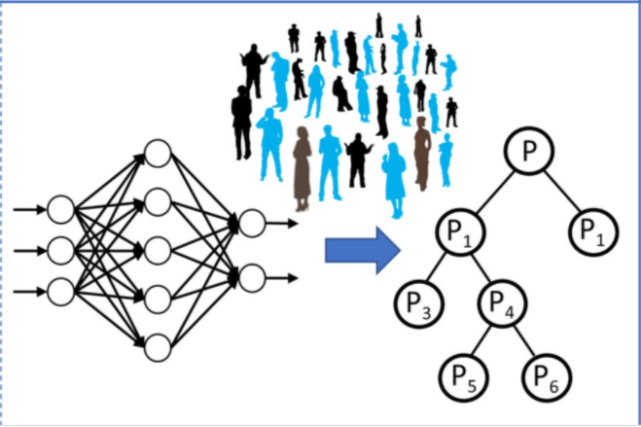
Global Self-Explaining

Slide 8
Global Self-Explaining cont.
Explainability Technique
Operations to Enable Explainability
Visualization Technique
Reinforcement Learning
Raw Declaration Representation
Induction

Slide 9
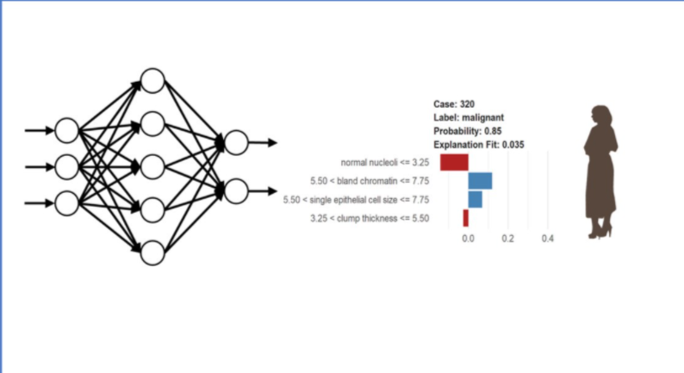
Local Self-Explaining

Slide 10
Local Self-Explaining cont.
Explainability Technique
Operations to Enable Explainability
Visualization Technique
Explainability- aware architecture/
Rule induction
Raw Declaration Representation
Induction

Slide 11
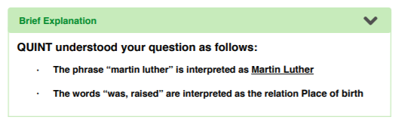
Local Self-Explaining cont.
Explainability Technique
Operations to Enable Explainability
Visualization Technique
Provenance
Template-Based
Natural Language

Slide 12
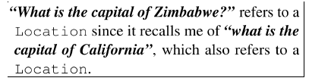
Local Self-Explaining cont.
Explainability Technique
Operations to Enable Explainability
Visualization Technique
Layer- Wise Relevance Propagation
Example-Driven
Raw Examples

Slide 13
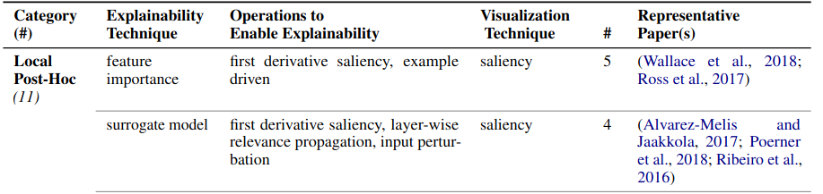
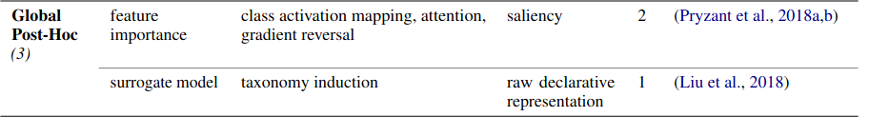
Post-Hoc
2,3
4,5
6
7

Slide 14
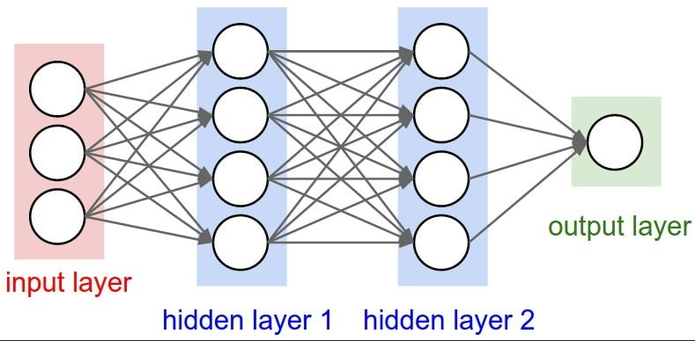
First Derivative Salincy
Layer-wise Relevance Propagation
Feature Importance

Slide 15
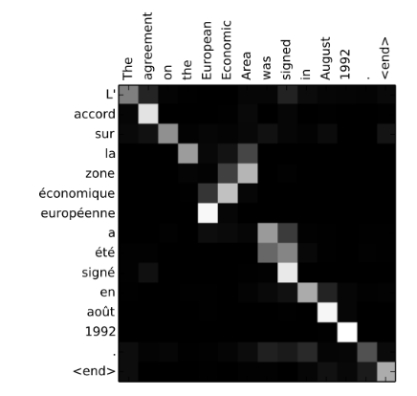
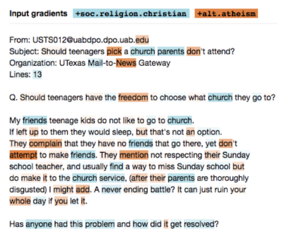
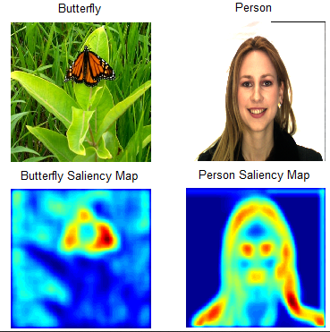
Visualisation: Saliency Maps

Slide 16
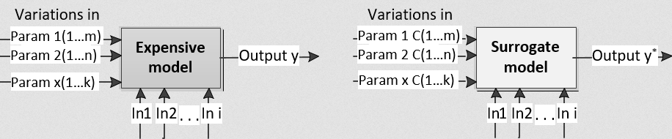
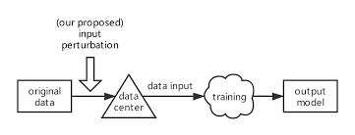
Surrogate Model
Input Perturbation

Slide 17
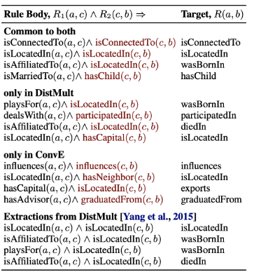
Visualisation: Raw Declarative Rules

Slide 18

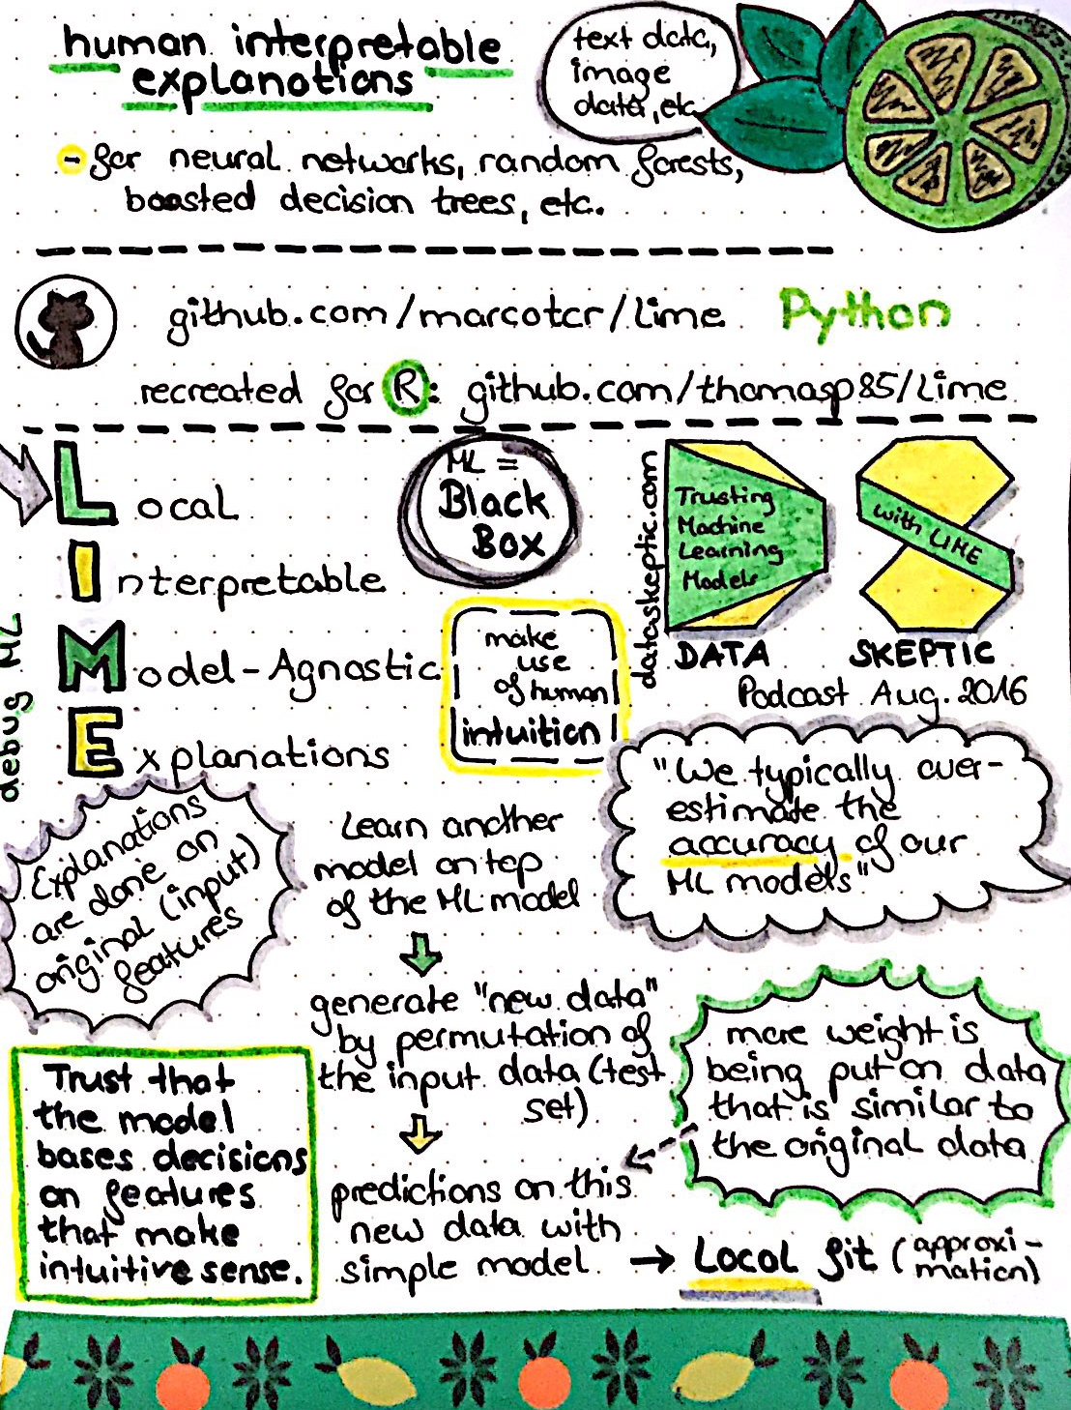

Evaluation !
Integration ?
Comprehensible ?
Fidelity ?
HOW ?
Human Annotators
Reference: LIME

Slide 19
Our Critique
Quality
Clarity
Originality
Significance
Good Tech., covered all papers with more focus on one
Well organized, logical flow, lack more details.
The 1st survey at that time, immensely needed to summarize main techniques.
Pointed out main challenges (Evaluation, standards, lack of global XAI) and some unknown techniques.

Slide 20

XAI waits for US…

Slide 21
Appendix
[1]Marina Danilevsky, Kun Qian, Ranit Aharonov, Yannis Katsis, Ban Kawas, Prithviraj Sen.2020.A Survey of the State of Explainable AI for Natural Language Processing.
[2]Eric Wallace, Shi Feng, and Jordan Boyd-Graber. 2018.Interpreting neural networks with nearest neighbors.In Proceedings of the 2018 EMNLP Workshop Black-box NLP: Analyzing and Interpreting Neural Networks for NLP, pages 136–144, Brussels, Belgium.Association for Computational Linguistics.
[3]Andrew Slavin Ross, Michael C. Hughes, and FinaleDoshi-Velez. 2017.Right for the right reasons:Training differentiable models by constraining their explanations. InProceedings of the Twenty-SixthInternational Joint Conference on Artificial Intelligence, IJCAI-17, pages 2662–2670.
[4]David Alvarez-Melis and Tommi Jaakkola. 2017. A causal framework for explaining the predictions ofblack-box sequence-to-sequence models.In Proceedings of the 2017 Conference on Empirical Meth-ods in Natural Language Processing, pages 412–421, Copenhagen, Denmark. Association for Com-putational Linguistics.

Slide 22
Appendix
[5]Nina Poerner, Hinrich Sch ̈utze, and Benjamin Roth.2018. Evaluating neural network explanation methods using hybrid documents and morphosyntactic agreement. InProceedings of the 56th Annual Meeting of the Association for Computational Linguistics (Volume 1: Long Papers), pages 340–350, Melbourne, Australia. Association for Computational Linguistics.
[6]Reid Pryzant, Sugato Basu, and Kazoo Sone. 2018a.Interpretable neural architectures for attributing an ad’s performance to its writing style. In Proceedings of the 2018 EMNLP Workshop BlackboxNLP: Analyzing and Interpreting Neural Networks for NLP,pages 125–135, Brussels, Belgium. Association for Computational Linguistics.
[7]Ninghao Liu, Xiao Huang, Jundong Li, and Xia Hu.2018. On interpretation of network embedding via taxonomy induction. InProceedings of the 24th ACM SIGKDD International Conference on Knowledge Discovery & Data Mining, KDD ’18, page 1812–1820, New York, NY, USA. Association for Computing Machinery.

Slide 23
Appendix
https://towardsdatascience.com/explainable-machine-learning-9d1ca0547ae0
http://repository.essex.ac.uk/27120/1/Towards%20Human%20Understandable%20Explainable%20AIv9.pdf
https://medium.com/@BonsaiAI/explainable-artificial-intelligence-using-model-induction-f257c92f426e
https://arxiv.org/ftp/arxiv/papers/1912/1912.05100.pdf
https://aclanthology.org/D17-2011.pdf

